Slide 1



Ethegram - a blockchain based decentralized social media application with reward system
BY
SRIVATSAV R (2019103066)
SACHIN RAGHUL T (2019103573)
SANJEEV KM (2019103576)

Slide 2

index
INTRODUCTION
LITERATURE SURVEY
PROBLEM STATEMENT
OBJECTIVE
SYSTEM ARCHITECTURE
LIST OF MODULES
EXPLANATION OF MODULES
IMPLEMETATION
CONCLUSION
REFERENCES

Slide 3

introduction
In this project, we propose Ethegram, a social media platform developed by using the state-of-the-art blockchain technology and introduce a social networking decentralized application.
The application is based on Ethereum blockchain platform for data records and IPFS for distributed data storage service.
The application would reward users for quality content they contribute on the platform.
BLOCKCHAIN
Blockchain is a continuously growing chain of blocks, each of which contains a cryptographic hash of the previous block, a time-stamp, and its conveyed data.
The data stored in a blockchain are inherently resistant to modification.
If one block of data is modified, all blocks afterward should be regenerated with new hash values. This feature of immutability is fundamental to blockchain applications.
Maintenance of peer-to-peer (P2P) ledgers for cryptocurrencies has become the first application of blockchain.

Slide 4
Literature survey
# | Author, Publication Year, Title | Proposed work | Algorithm Used | Advantages | Limitations
1. | Ningyuan Chen, David Siu-Yeung Cho, A Blockchain based Autonomous Decentralized Online Social Network, 2021 | Online Social Network (OSN) using Decentralized Autonomous Organization (DAO) | Decentralized Autonomous Organization (DAO) and IPFS based algorithm | DAO is developed for user autonomy, users can self-manage the OSN in a democratic way | The simulate plan doesn’t motivate users to create more high-quality content and pay their effort in the autonomy part
2. | Q. Xu, K. M. M. Aung, Y. Zhu, and K. L. Yong, New Advances in the Internet of Things. Springer, 2018, pp. 119–138. | A blockchain-based storage system for data analytics in the internet of things | OSD-based smart contract (OSC) | Secured blockchain based storage | Hard to implement it’s prototype
3. | IPFS. [Online]. Available: https://ipsfs.io/ (2018) | Interplanetary file system for handling file uploads | Peer 2 peer algorithm | Interplanetary file system for handling file uploads is best way | IPFS consumes a lot of bandwidth which is not appreciated by metered internet users.

Slide 5
LITERATURE SURVEY
# | Author, Publication Year, Title | Proposed work | Algorithm Used | Advantages | Limitations
4. | A. Tar. (July 26 2018) Smart contracts, explained. [Online]. Available: https://cointelegraph.com/ explained/smart-contracts-explained. | Explanation for the programs stored on a blockchain that run when predetermined conditions are met. | Ethereum smart contracts | automatically controls the transfer of digital assets between the parties under certain conditions | Difficult to change. Changing smart contract processes is almost impossible, any error in the code can be time-consuming and expensive to correct.
5. | Antorweep Chakravorty and Chunming Rong, Ushare, Conference Paper – January 2017. | User controlled social media based on blockchain | Personal Certiﬁcate Authority (PCA) DECENT algorithm | support oﬀsite encryption of data and mechanisms to share them through the blockchain. | a token value reaches zero, it reverts to the previous state and does not allow any future share of that data item.
6. | Q. Xu, C. Jin, M. F. B. M. Rasid, B. Veeravalli, and K. M. M. Aung, Multimedia Tools and Applications, pp. 1–26, 2017 | Blockchain-based decentralized content trust for docker images | DTC algorithm | protection against a single point of failure removes the need of a central authority to manage trust | Limited Protection against Server Compromise Potential DoS Attack

Slide 6
Literature survey
# | Author, Publication Year, Title | Proposed work | Algorithm Used | Advantages | Limitations
7. | Buterin, Ethereum White Paper. 2014, p.23. | A NEXT GENERATION SMART CONTRACT & DECENTRALIZED APPLICATION PLATFORM | Ethereum smart contracts | Backup, speed, safety, accuracy is obtained on using Ethereum smart contracts. | Possibility of loopholes and vague terms
8. | M. Andrychowicz, S. Dziembowski, D. Malinowski,and L. Mazurek. In 2014 IEEE Symposium on Security and Privacy, pages 443–458. IEEE, 2014 | Secure multiparty computations on bit coin | Bitcoin cryptocurrency wallet | Secure and no charge backs (lower transaction fees) | The value of Bitcoins is constantly fluctuating according to demand which would not please the user that the reward we are offering
9. | Datta, A.; Buchegger, S.; Vu, L.H.; Strufe, T.; Rzadca, K. In Handbook of Social Network Technologies and Applications; Springer: Boston, MA, USA, 2010; pp. 349–378 | Decentralized Online Social Networks | distributed ledger technology, cryptography and P2P (peer-to-peer) | develop a distributed algorithm to detect the dynamic community | By analyzing the dynamic results, we show that the network is very shattered and not even close to the static view.

Slide 7
Problem statement
As we are aware, Facebook provides decent service at the extremely high cost of constantly disregarding user privacy, common decency, and laws around the world, and yet they still have billions of users as they are the monopoly.
Monopolies breed complacency, low quality, and high costs. And Facebook has a monopoly over your friend network. We can’t leave because everyone is on Facebook. Switching to a new platform means every single one of your friends has to make a new account, download a new app, and you have to rebuild that whole network—if you can convince them at all.
It’s the same story for any platform (though most don’t charge such a high price), and it’s unavoidable. Hence, we believe the solution is a decentralized social network which is encrypted.

Slide 8
objective
Online social networks (OSN) are becoming more important in people’s daily life, however, all popular OSNs are centralized, and this raises a series of security, privacy and management issues. A decentralized architecture based on blockchain technology provides the ability to solve above issues. In this paper, an OSN service is developed based on blockchain technology in order to make it operate decentralized. Large volume of data norm ally required low-security requirements can be stored in Interplanetary Filesystem (IPFS) to make data decentralized. A decentralized autonomous organization is developed for user autonomy, users can self-manage the OSN in a democratic way.

Slide 9
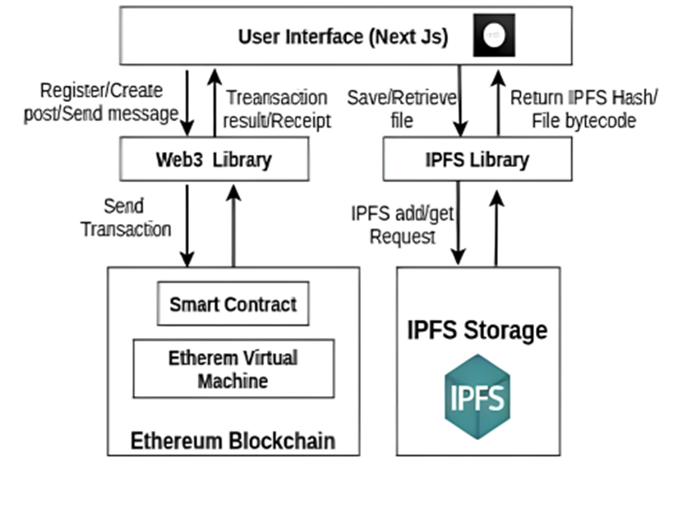
System architecture

Slide 10


LIST OF MODULES
Process for registering
Process for creating post
Reward System

Slide 11
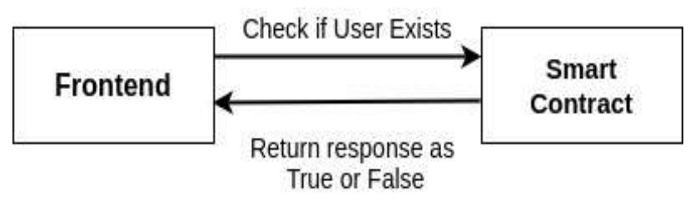
Process of registering
When the client starts, the user can register into the application only if he/she is not already registered. This is handled by the users mapping and frontend.
If the account address of user already exists in the users mapping, the frontend registration is disabled, else the frontend sends a transaction along with 0.002 Ether (the cryptocurrency of Ethereum blockchain) to the blockchain and a new user account is registered with the application.
This amount goes into the contract balance and it enables the contract to reward the users based on the likes (or upvotes) their content gets. It also discourages malicious actors to get registered on the application.

Slide 12
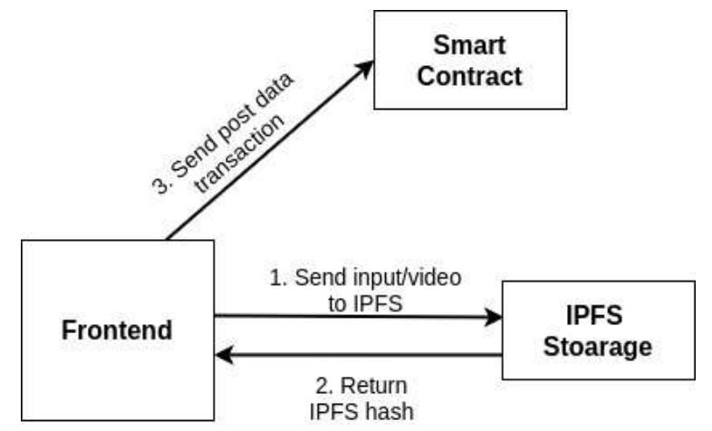
Process of creating post
While creating a new post, if an image or video is uploaded by the user along with the post, the frontend client loads the image or video into a byte array and sends the byte data to IPFS storage endpoint through IPFS library.
When the data storage is successful, it returns the corresponding IPFS hash in return. This hash is stored on the blockchain and is later used to retrieve the image or video when required.
All the post data along with creator's address, image/video IPFS hash and current timestamp is sent as a transaction to the blockchain along with an amount of 0.001 Ether to the blockchain and the post is created. Other users can now like (upvote) or comment on the post

Slide 13

Reward system
When the user creates a post, other users of the application can view and upvote the post if they like the content. Each upvote generates a single token in the application account of the creator.
This token count can be seen in the UI profile section of the user. These tokens can be redeemed into Ethers from the platform itself. The funds are directly transferred to the account address from the contract balance.
Each token when redeemed gives 0.0001 Ether. Thus, the cost of creating a new post is recovered when the user receives 10 upvotes on his post.
More upvotes would ensure that the one-time registration cost is also recovered. This makes the rewards system purely content dependent.
Content creators are rewarded only based on how much their content is liked by other users of the application.

Slide 14
IMPLEMENTATION 20%

Slide 15
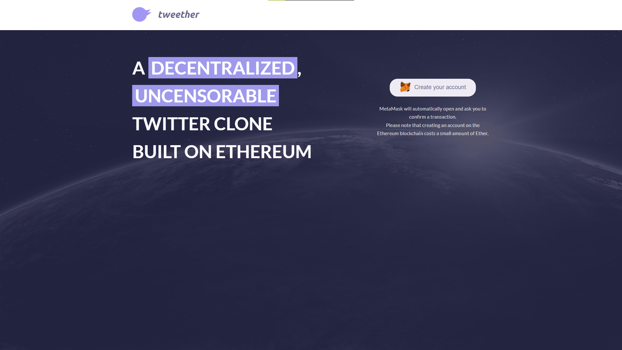
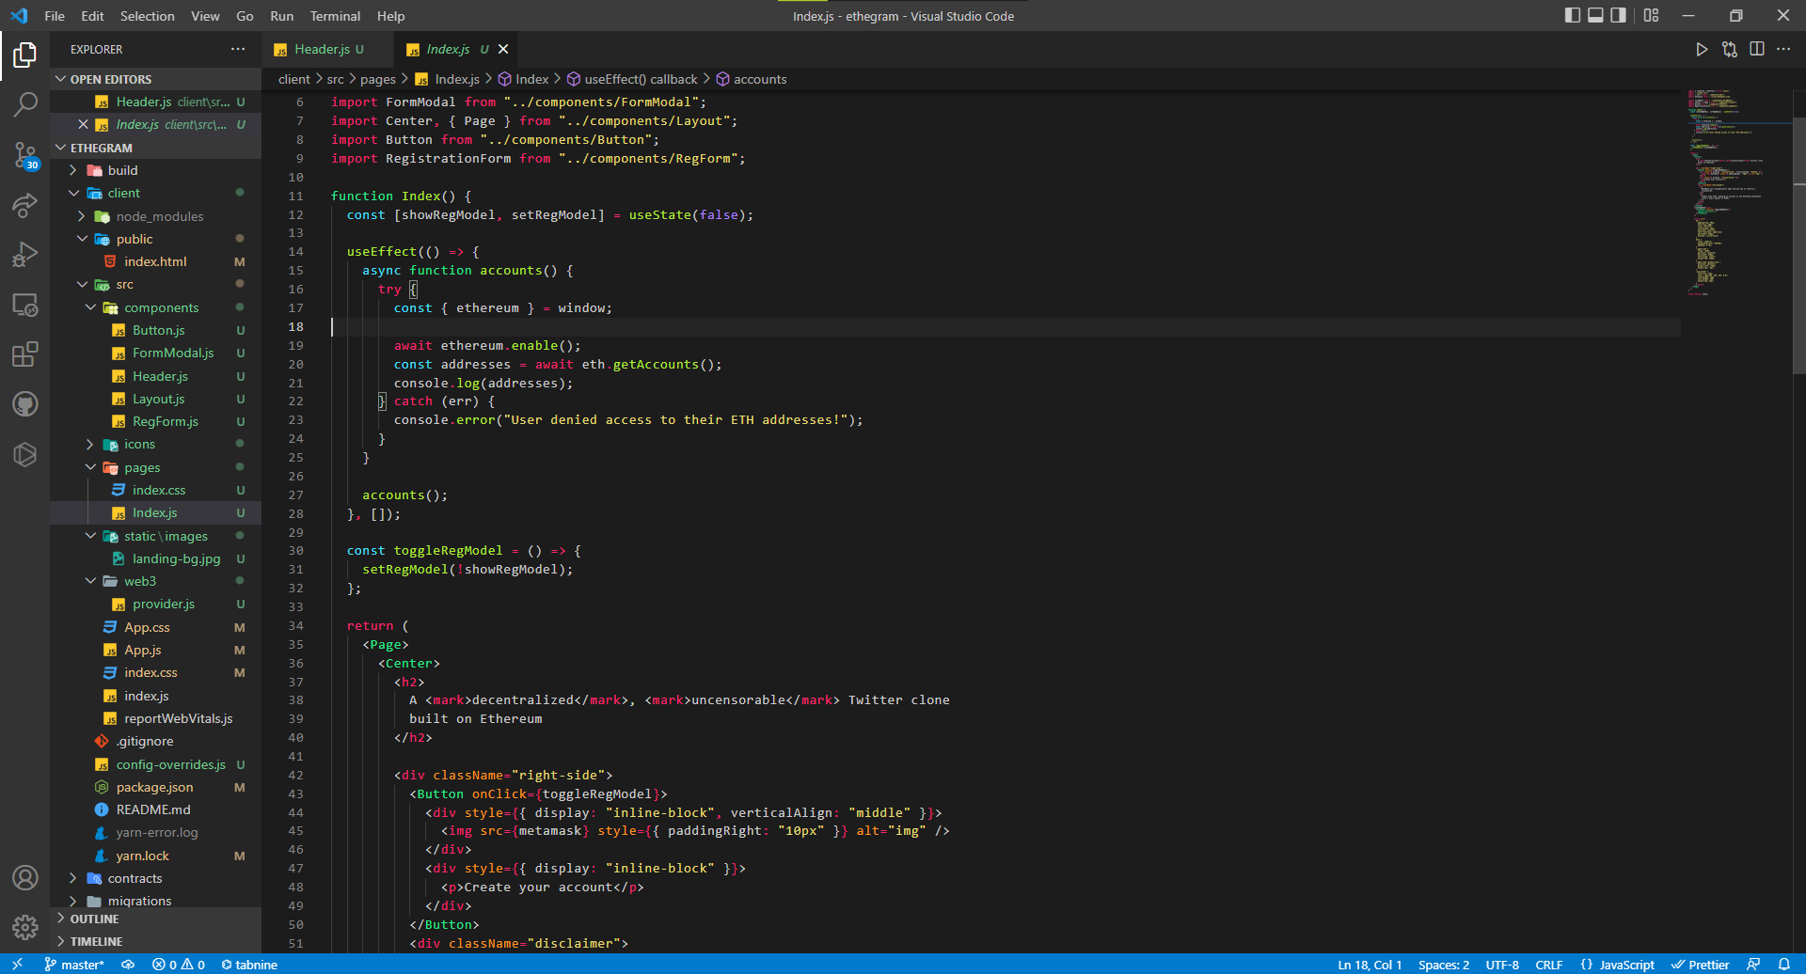
UI BUILD

Slide 16
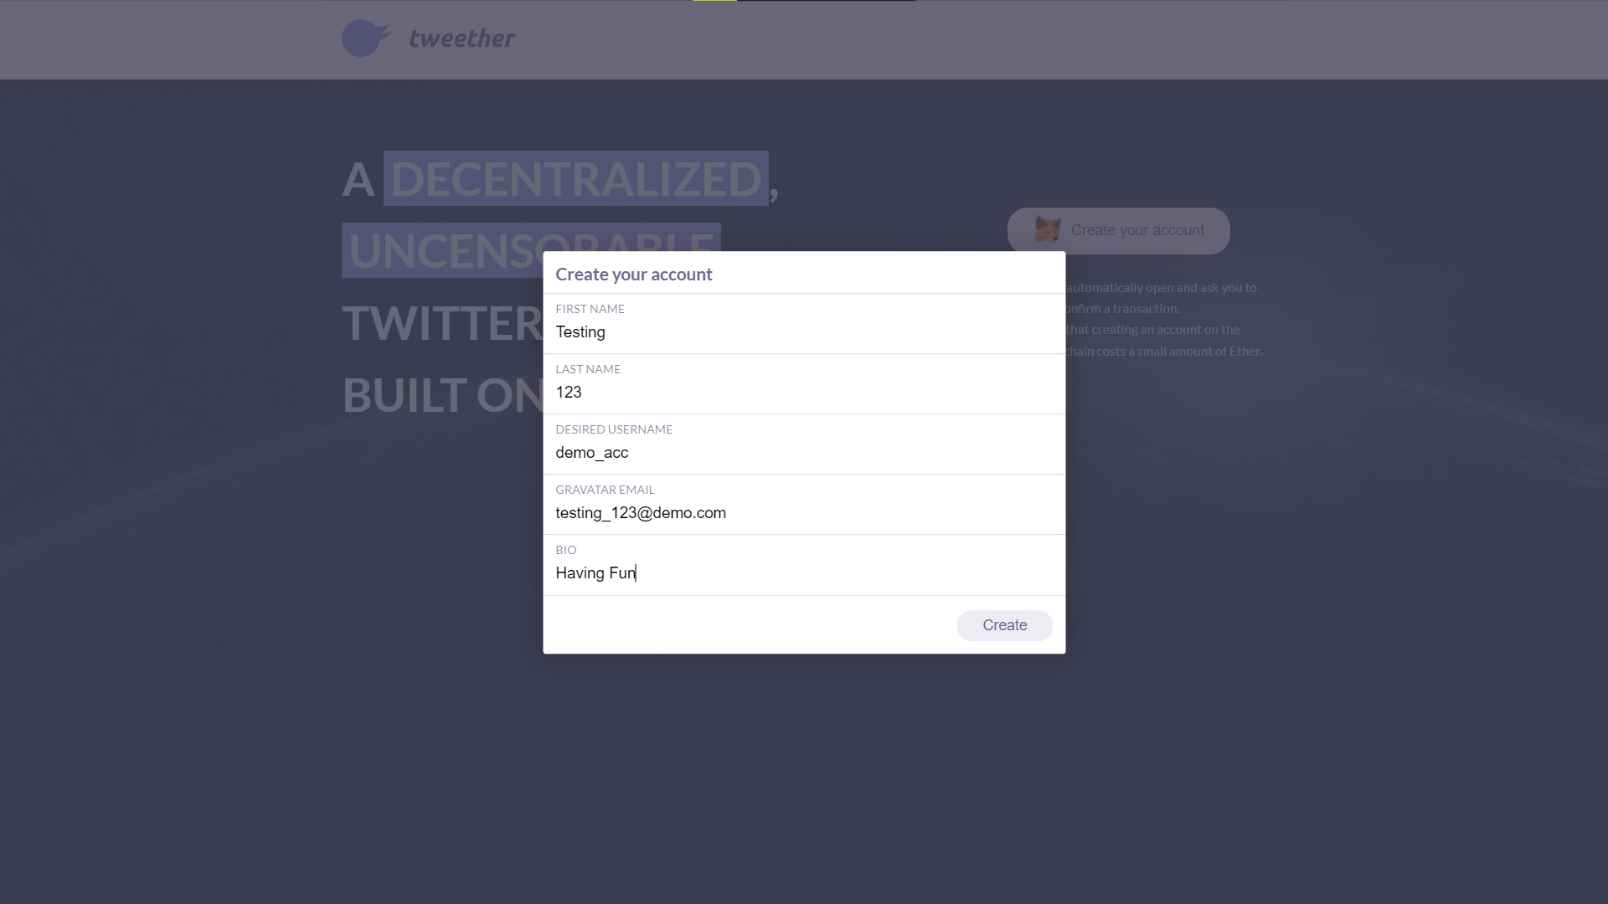
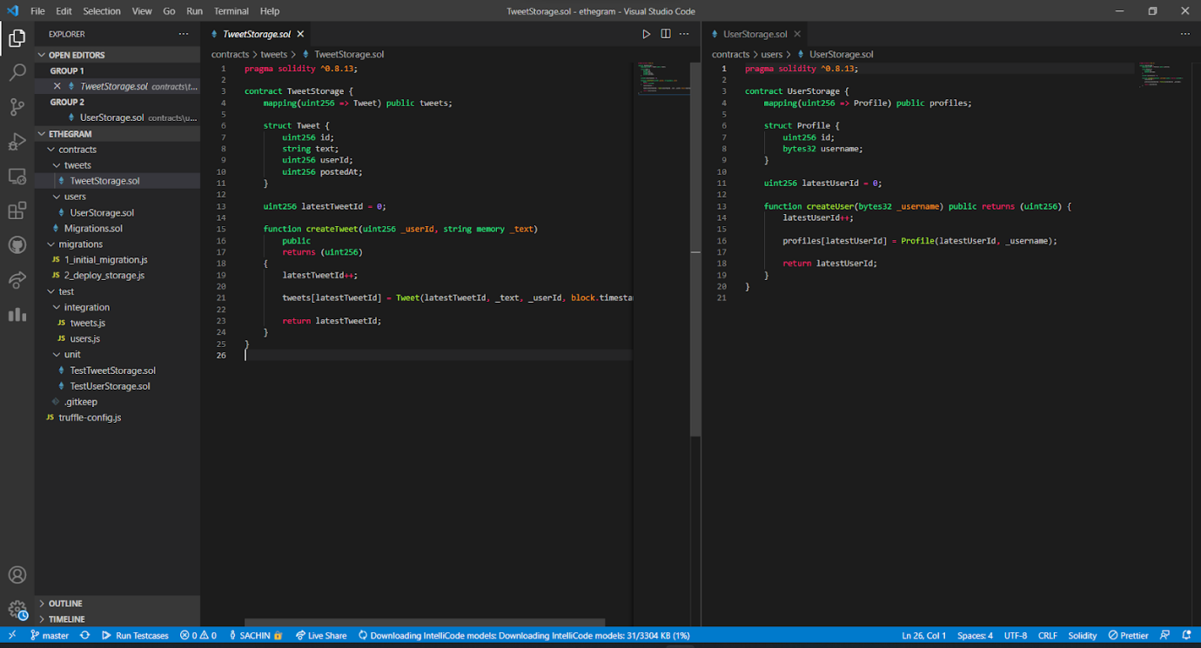
USER ACCOUNT CREATION

Slide 17
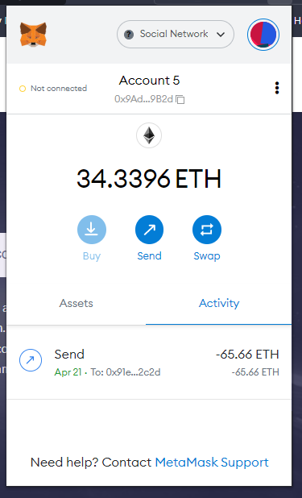
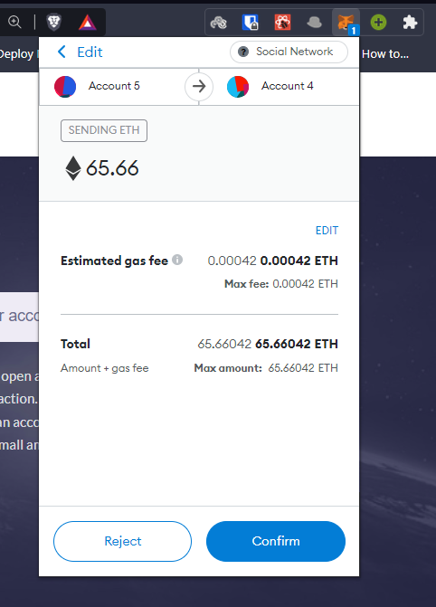
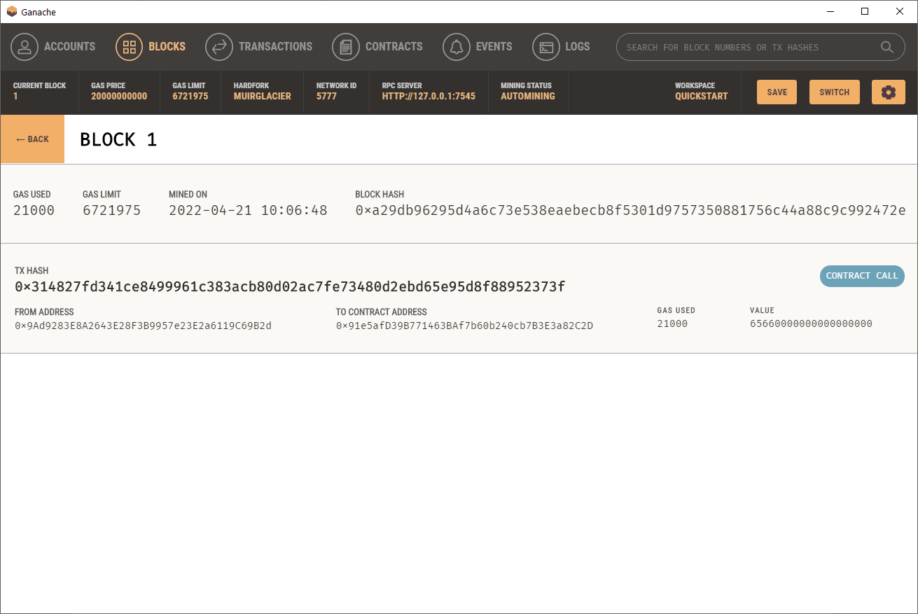
BLOCK CREATION

Slide 18
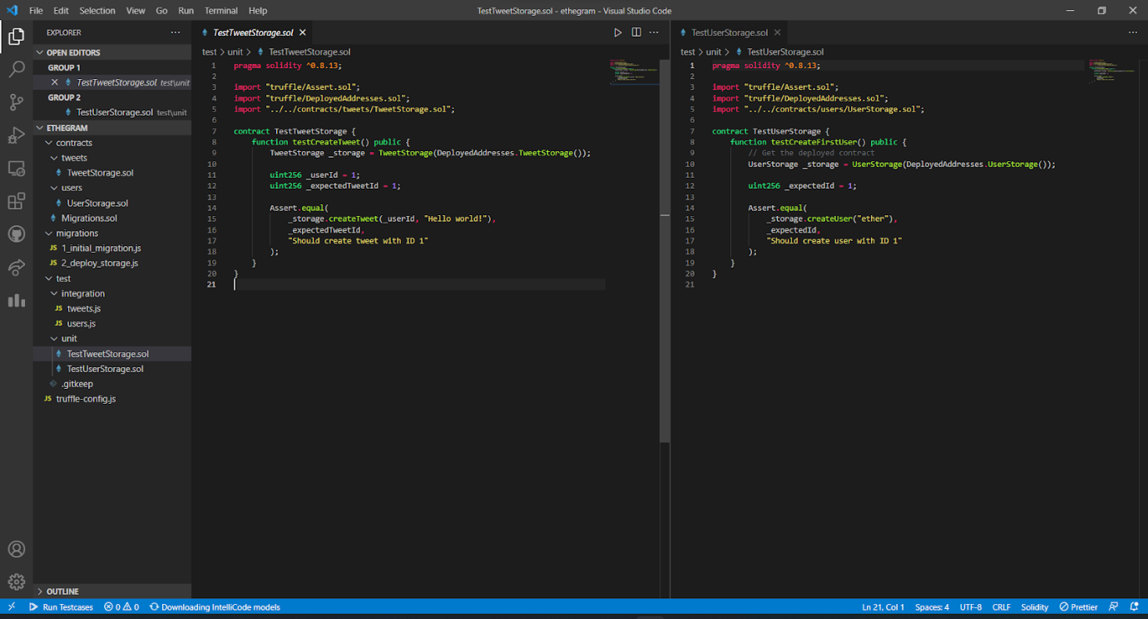
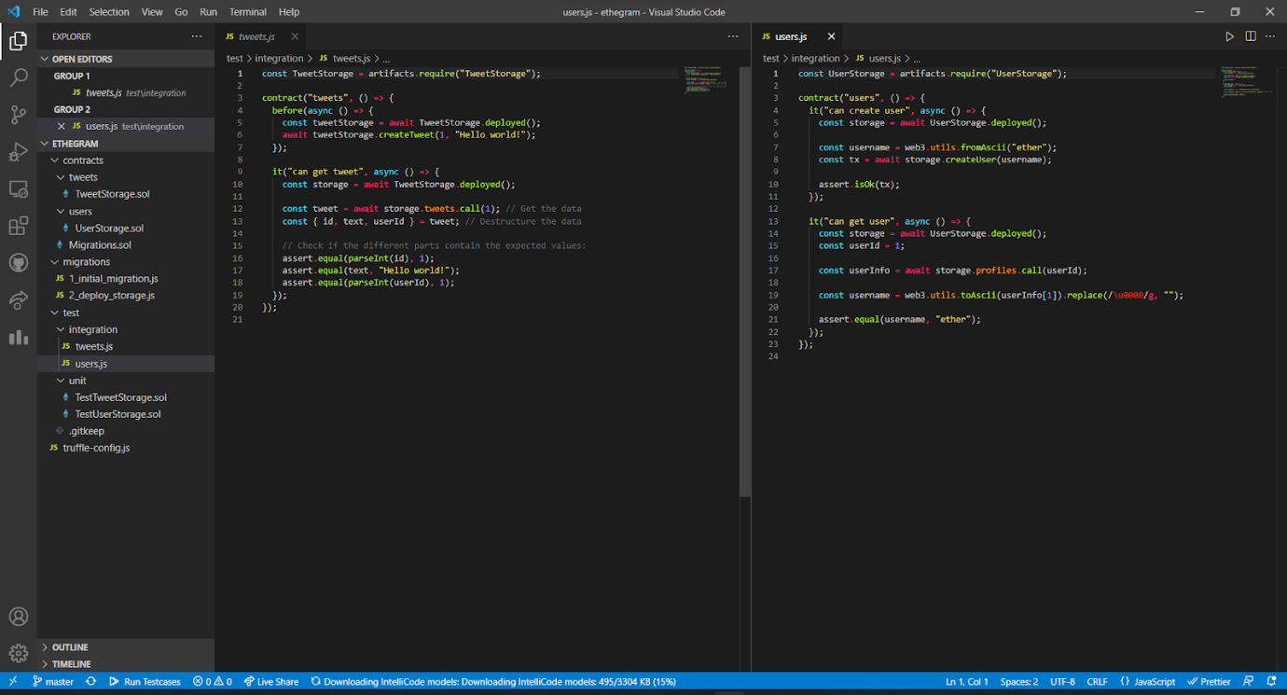
STORAGE CONTRACTS AND UNIT TESTING

Slide 19
IMPLEMENTATION 50%

Slide 20
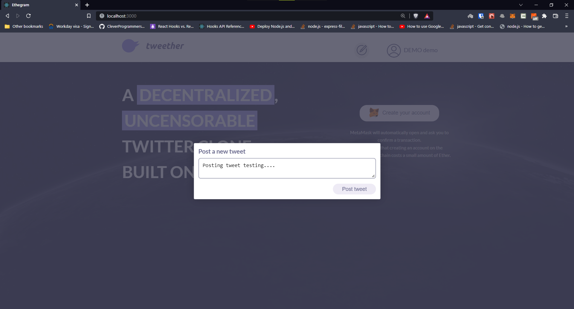
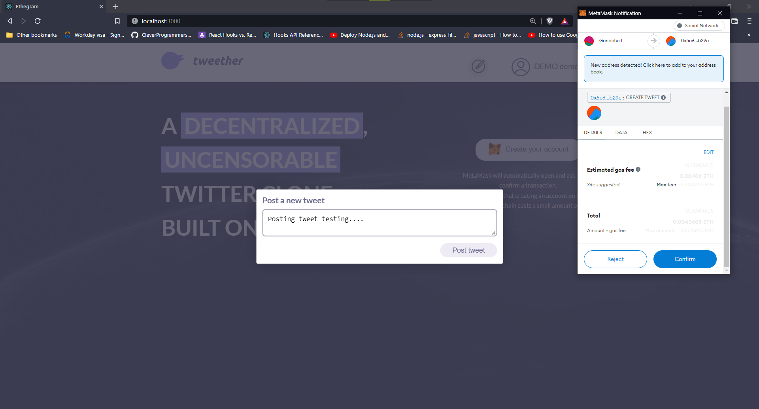
POSTING TWEETS

Slide 21
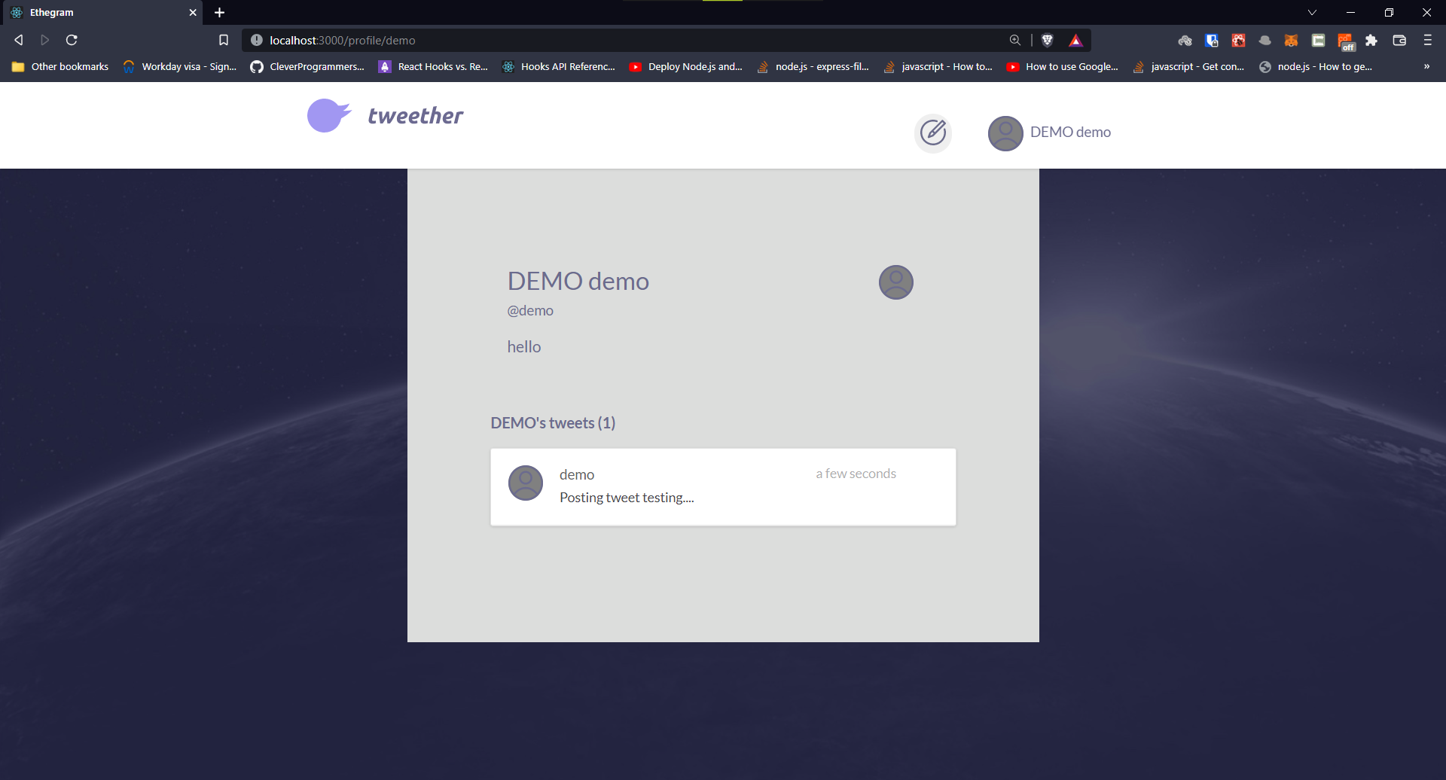
PROFILE PAGE

Slide 22

TWEET STORAGE CONTRACT (updt.)

Slide 23

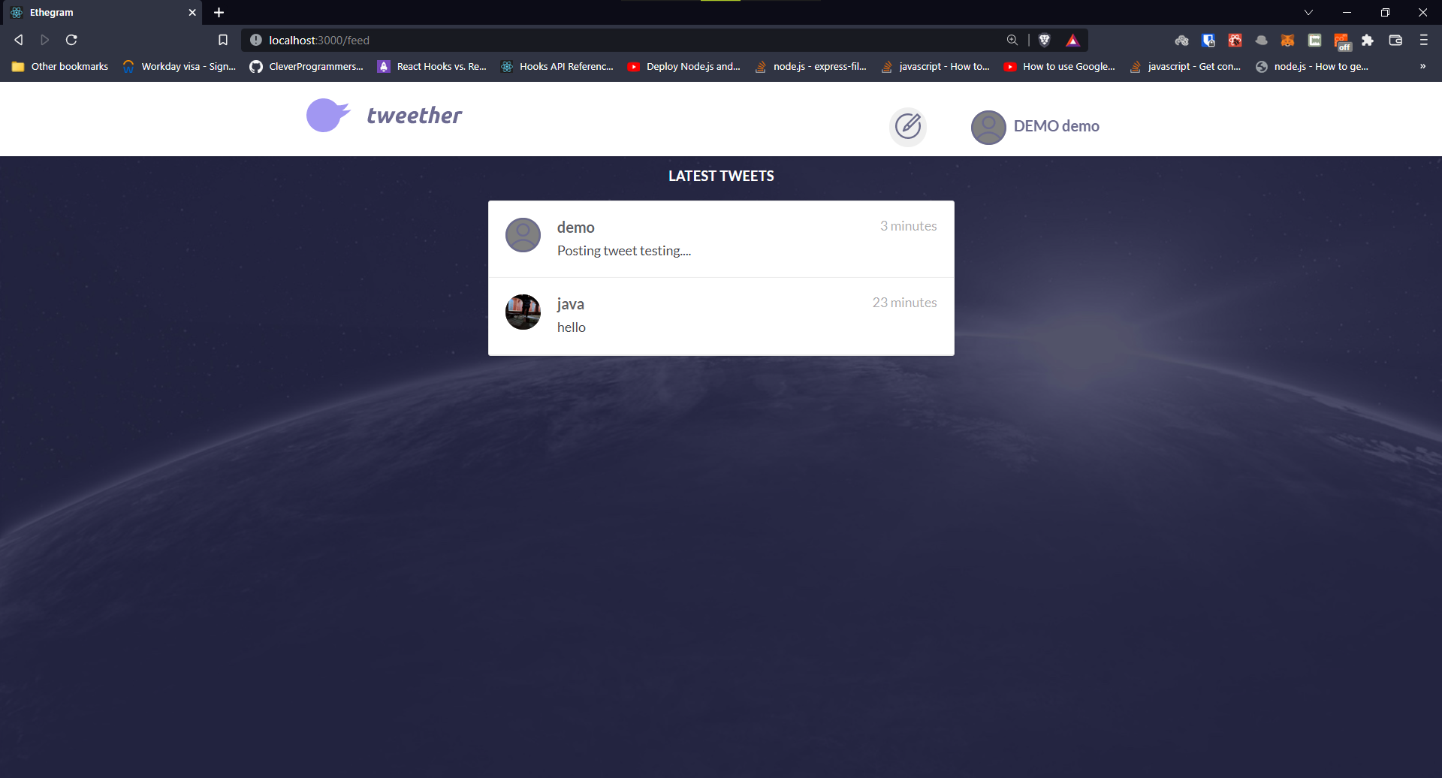
TWEET CONTROLLER AND FEED PAGE

Slide 24
IMPLEMENTATION 70%

Slide 25
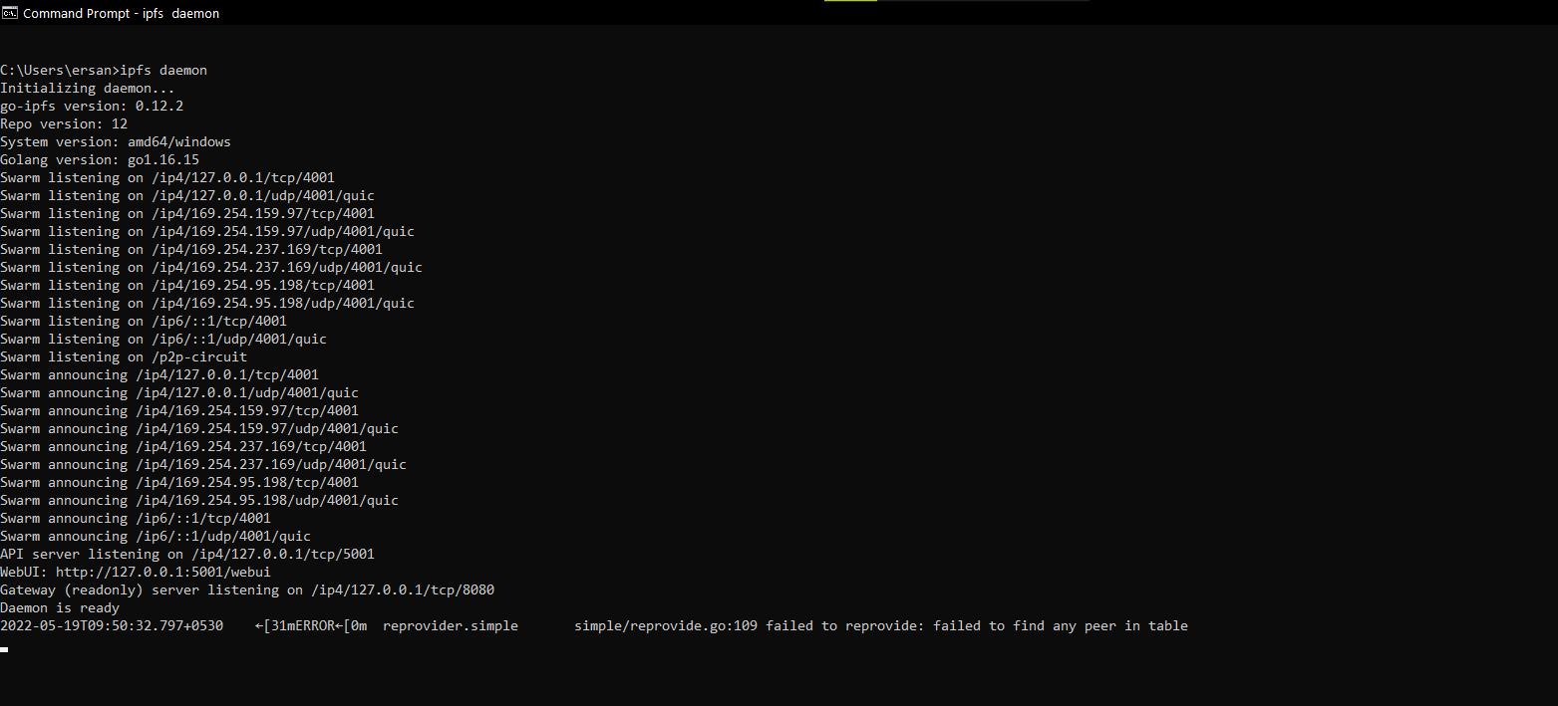
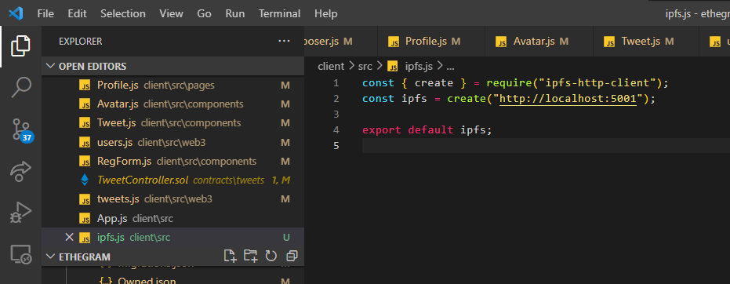
CONNECTING APPLICATION WITH IPFS

Slide 26
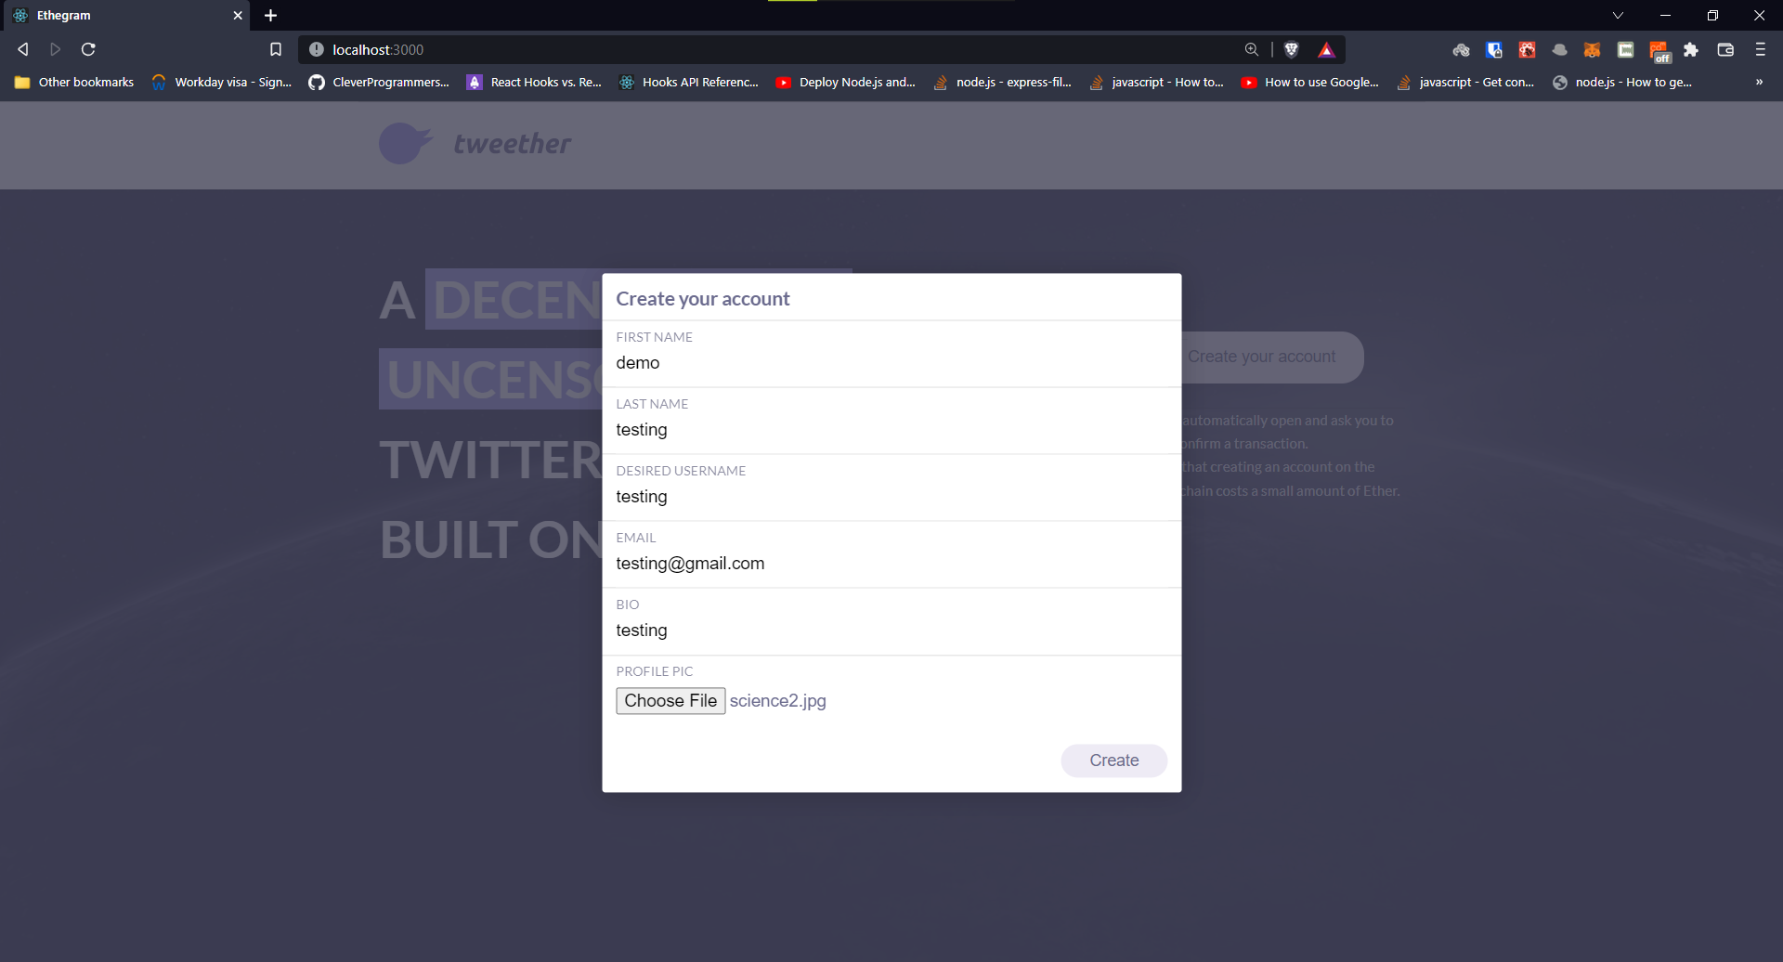

SENDING FILE BUFFER TO IPFS

Slide 27
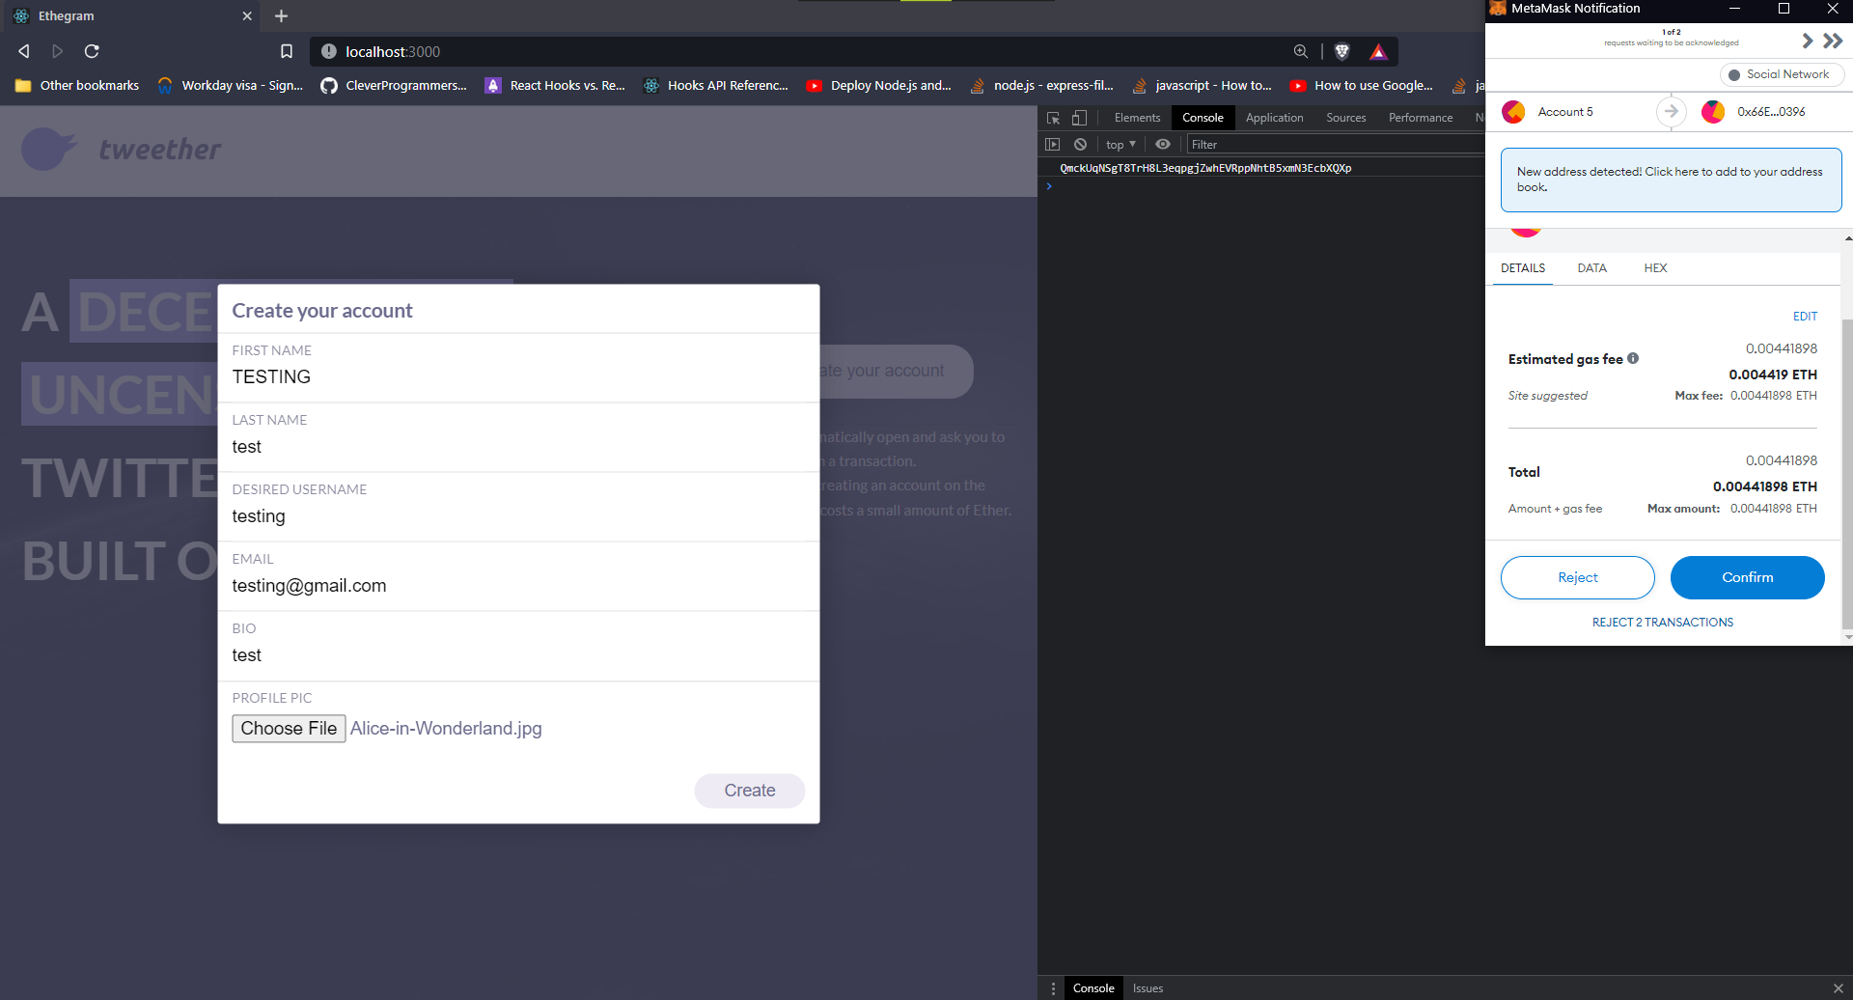
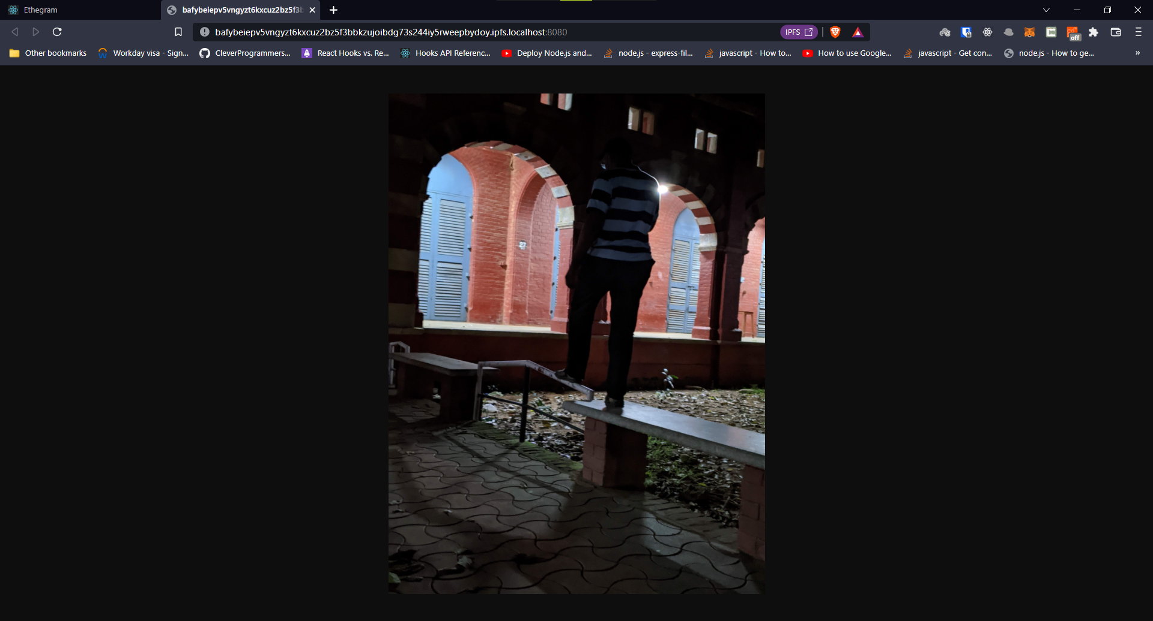
File access from ipfs

Slide 28
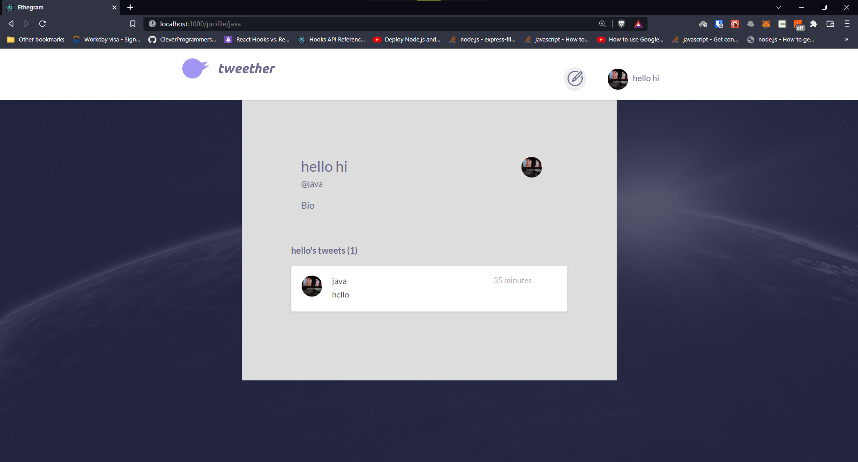
Integrating ipfs file to profile page

Slide 29
IMPLEMENTATION 100%

Slide 30
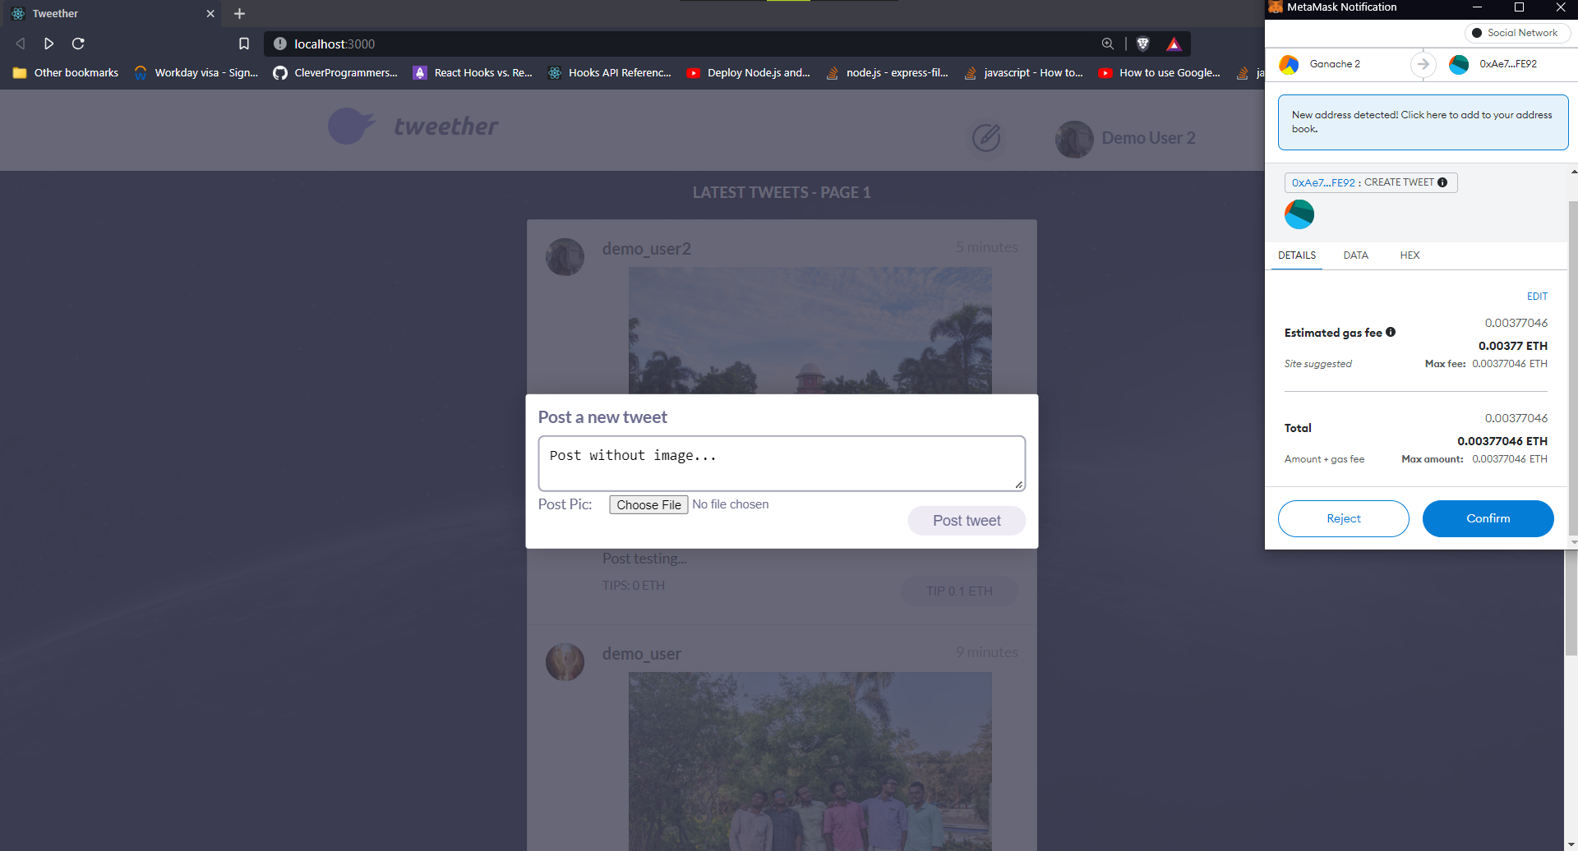
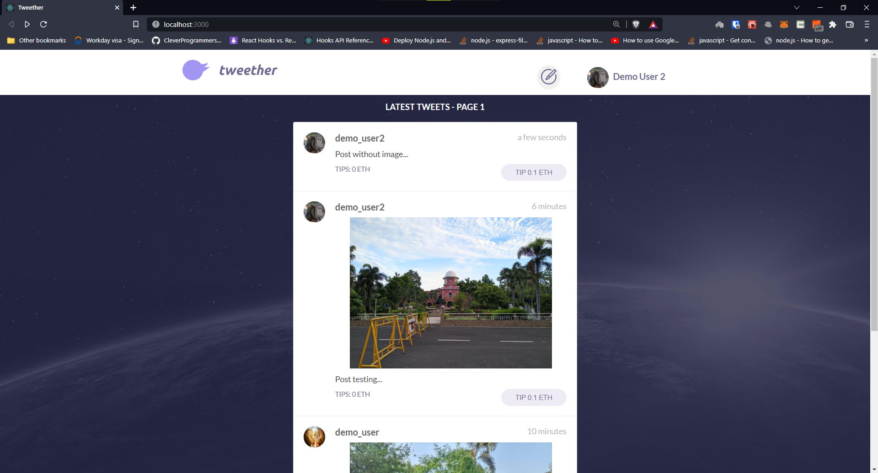
CREATE POST WITH AND WITHOUT IMAGE

Slide 31
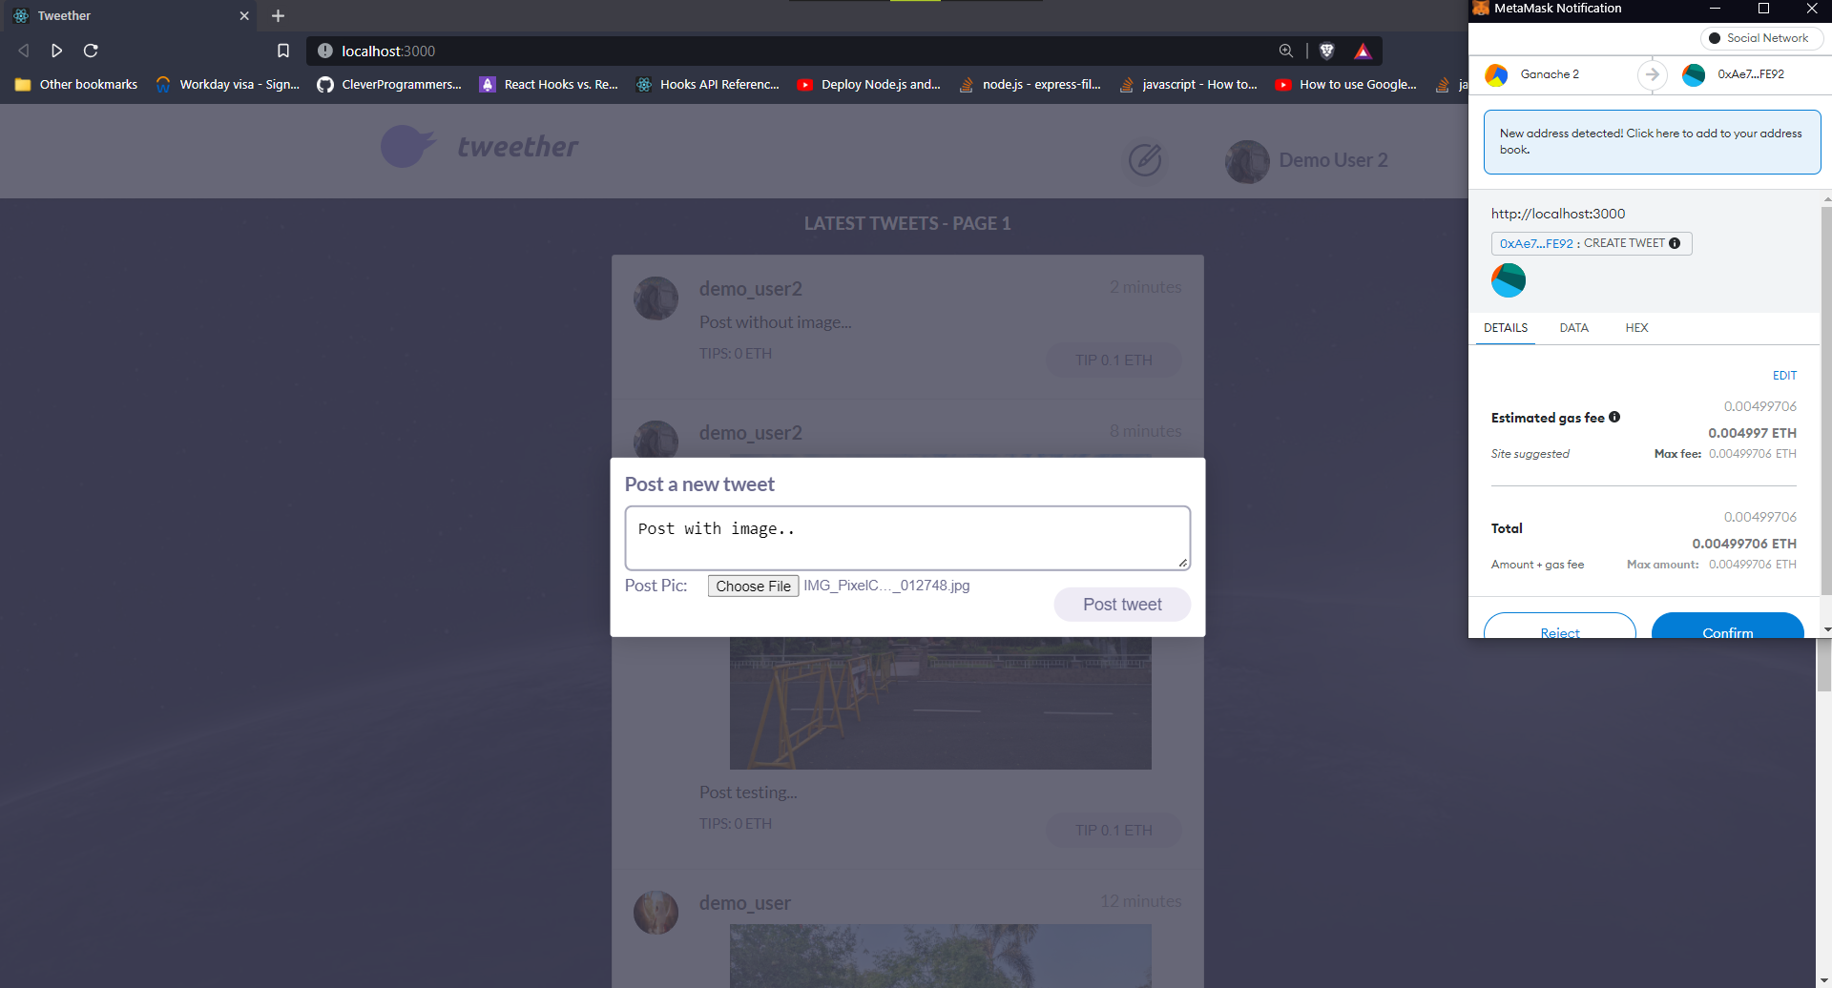
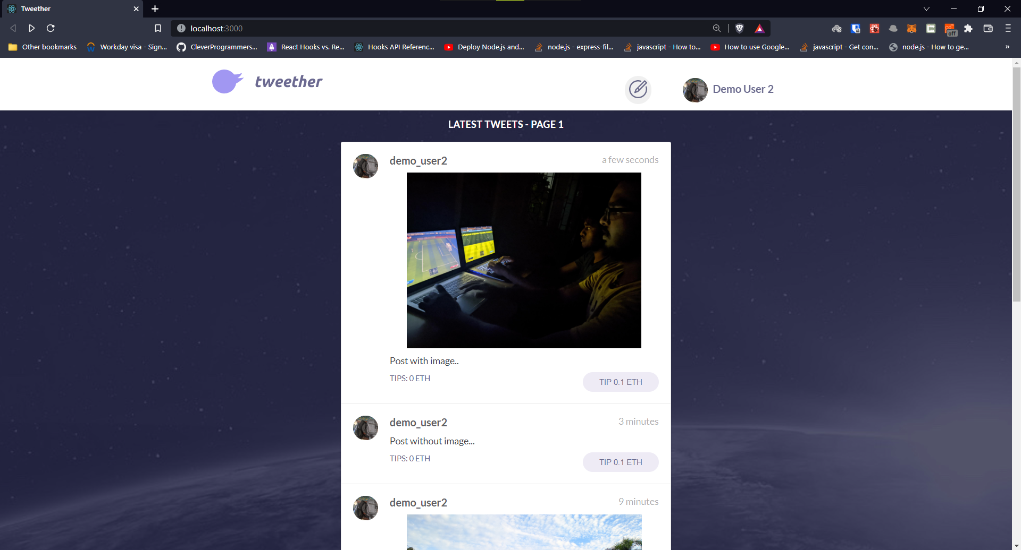
CREATE POST WITH AND WITHOUT IMAGE

Slide 32
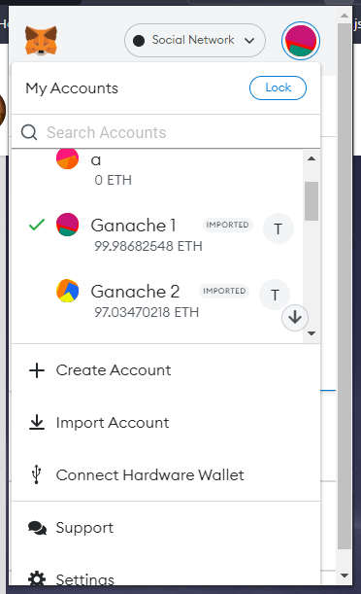
Post tipping
INITIAL BALANCE OF demo user (Ganache 1) and demo user2 (Ganache 2)

Slide 33
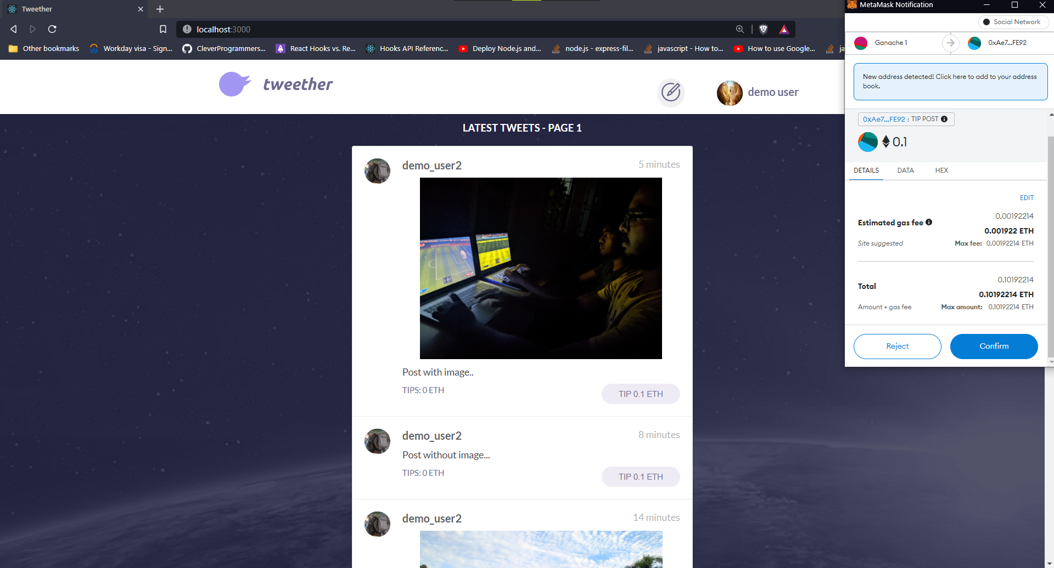
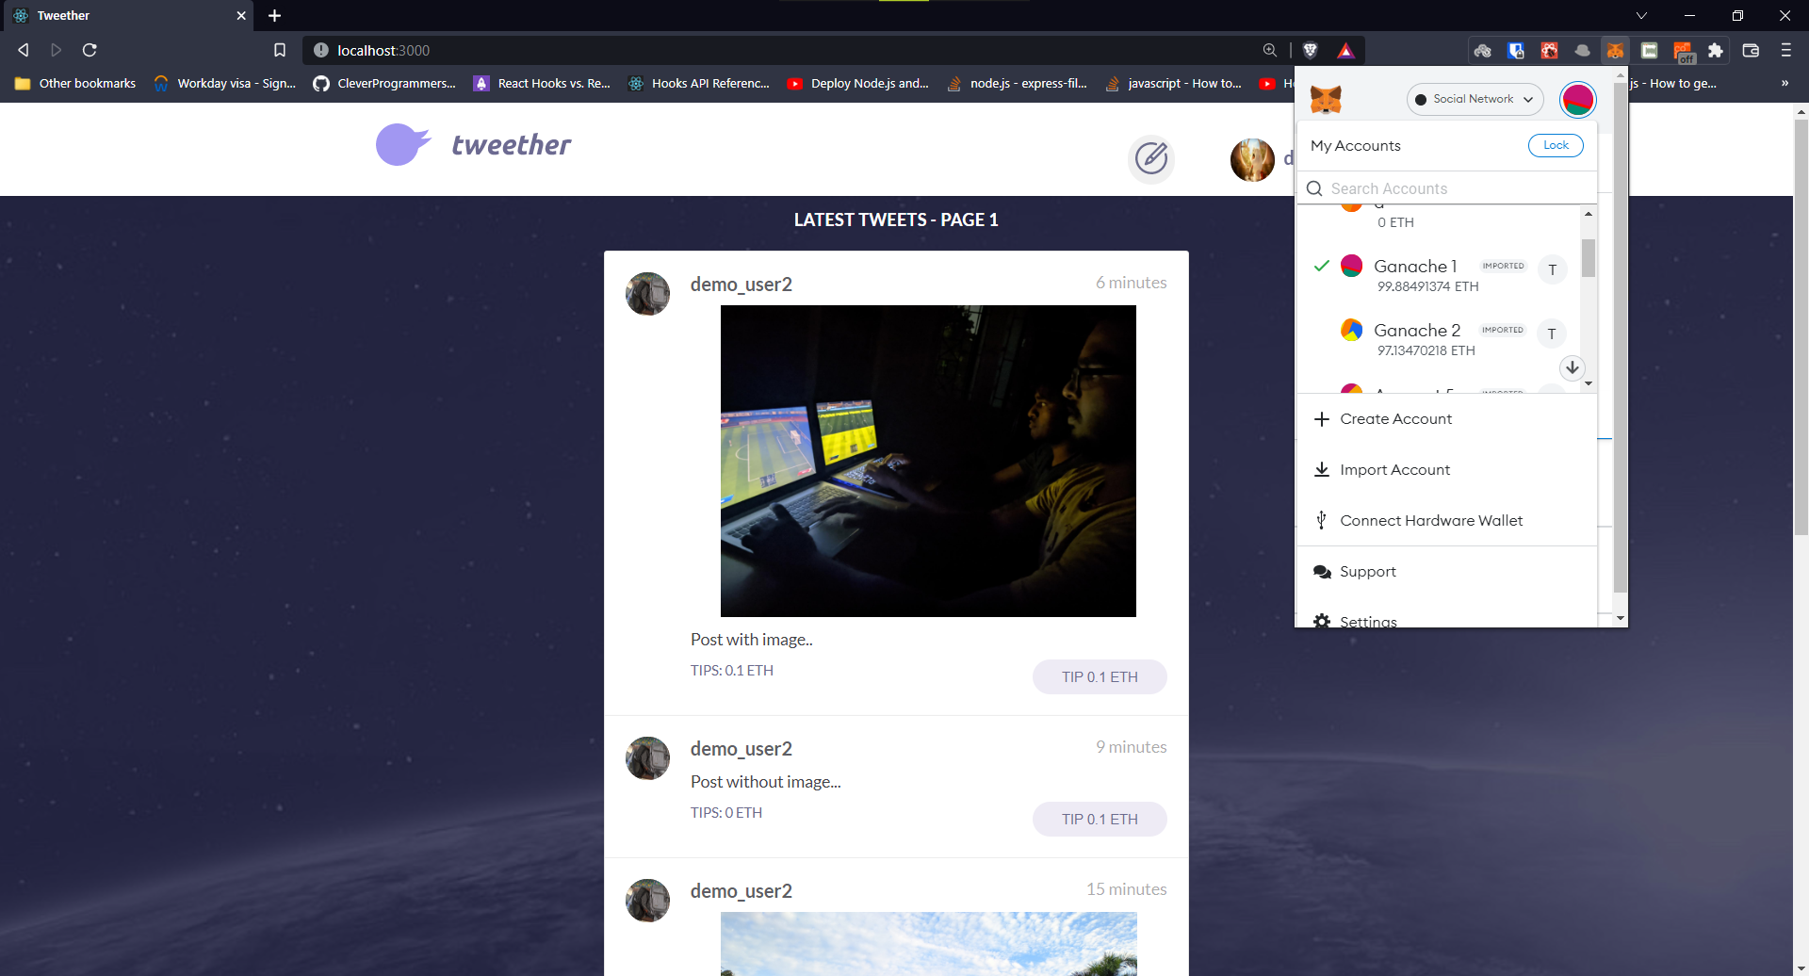
demo user TIPS 01.ETH TO POST CREATED BY demo user2
0.1 ETH GOT TRANSFERED FROM WALLET OF demo user TO demo user2

Slide 34
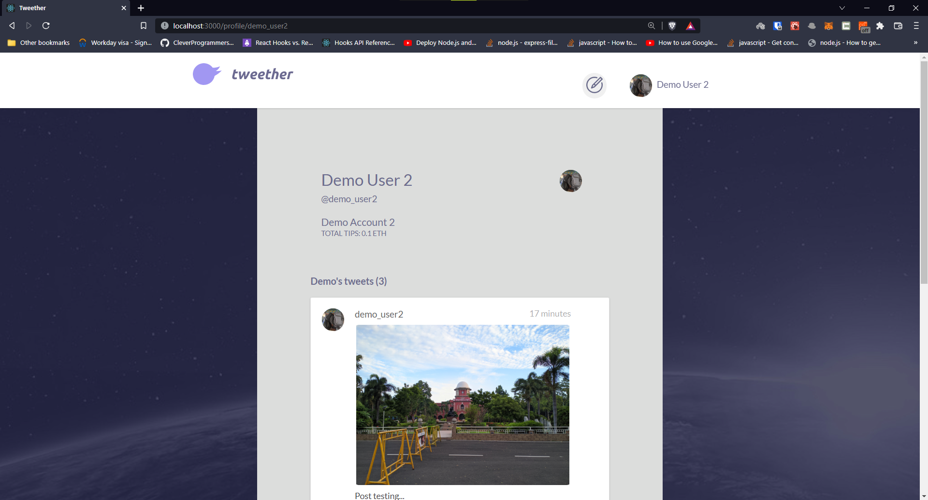
Profile page

Slide 35
cONCLUSION
As a result, a decentralised social network has been devised and implemented, which answers the questions highlighted previously. As a result, only the users control the content they upload in our Tweether application. Everyone's data is just 'out there,' in encrypted blobs that anybody may host or download but that only friends can decipher. Decentralization also makes it resistant to censorship, internet disruptions, and potential social monopolies. The decentralised social network paradigm has not only security, which is not difficult with public key cryptography, but also user-friendly security, which allows us to have the conveniences we've come to expect from centralised systems while keeping the network secure and open to anyone who wants to interact with it in any way they want.
Future Works
Future work needs to be done in order to develop the same as a mobile application without compromising on any of the aspects of web application. The smart contract of the application can also be improved since Solidity, the language of Ethereum Smart Contracts, currently does not support passing of complex data structures like multi-dimensional arrays.

Slide 36
References
[1] (2018) Facebook Cambridge Analytica data scandal. [Online]. Available: https://en.wikipedia.org/wiki/Facebook%E2%80%93C ambridge Analytica data scandal.
[2] Quanqing Xu, Zhiwen Song, Rick Siow Mong Goh, Yongjun Li, "Building an Ethereum and IPFS-based Decentralized Social Network System", 2018 IEEE 24th International Conference on Parallel and Distributed Systems (ICPADS).
[3] Q. Xu, C. Jin, M. F. B. M. Rasid, B. Veeravalli, and K. M. M. Aung, "Blockchain-based decentralized content trust for docker images", Multimedia Tools and Applications, pp. 1–26, 2017.
[4] (2018) Ethereum project. [Online]. Available: https://www.ethereum.org/.

Slide 37
References (contd...)
[5] (2018) Interplanetary file system. [Online]. Available: https://ipfs.io/.
[6] Q. Xu, K. M. M. Aung, Y. Zhu, and K. L. Yong, “A blockchain-based storage system for data analytics in the internet of things,” in New Advances in the Internet of Things. Springer, 2018, pp. 119–138.
[7] A. Tar. (July 26 2018) Smart contracts, explained. [Online]. Available: https://cointelegraph.com/ explained/smart-contracts-explained.
[8] (2018) Akasha project. [Online]. Available: https://akasha.world/.
[9] Antorweep Chakravorty and Chunming Rong, “Ushare: user controlled social media based on blockchain”, Conference Paper – January 2017

Slide 38
Welcome

